Slide 1
Chicago Census Data
Samantha Gibeault-Bownes
May 2024

Slide 2

Summary
Some trends between the “Age” demographics and “Financials”
Scope of age demographics
PERCENT_AGED_25__WITHOUT_HIGH_SCHOOL_DIPLOMA
PERCENT_AGED_UNDER_18_OR_OVER_64
Scope of financials
PERCENT_OF_HOUSING_CROWDED
PERCENT_HOUSEHOLDS_BELOW_POVERTY
PER_CAPITA_INCOME
HARDSHIP_INDEX
“PERCENT_AGED_16__UNEMPLOYED not relevant at this time due to limitations

Slide 3

METHODOLOGY
Chicago 2021 Census
78 different communities within Chicago
Average of each metric taken
Can a link between communities and financial standing be drawn?
Can a link between age and financial standing be drawn?

Slide 4
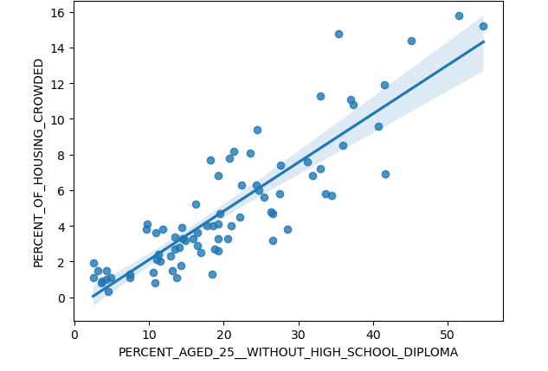
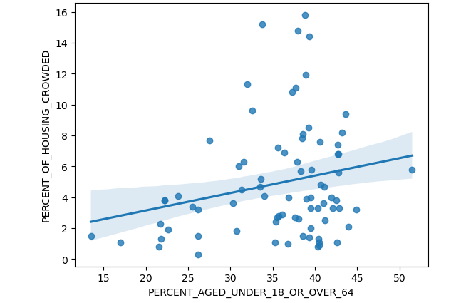
Citizens Living in Crowded Housing
Corr=0.875959
Corr=0.224692

Slide 5
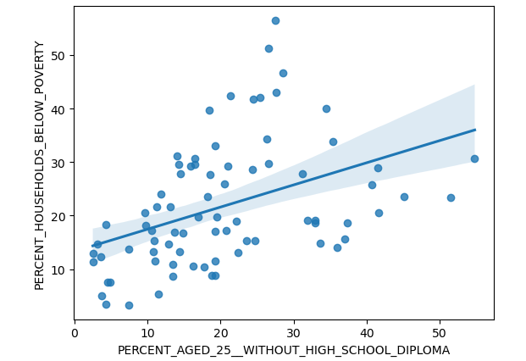
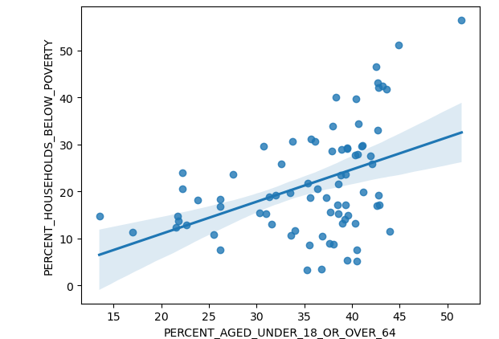
Citizens Living Below Poverty Line
Corr=0.435894
Corr=0.424294

Slide 6
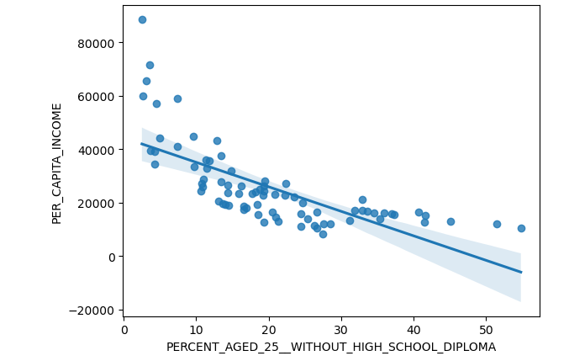
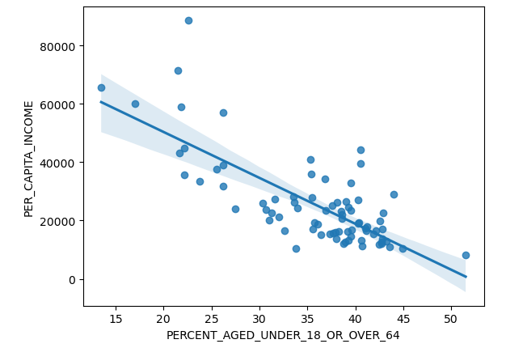
Per Capita Income of Citizens
Corr= -0.70977
Corr=-0.754844

Slide 7
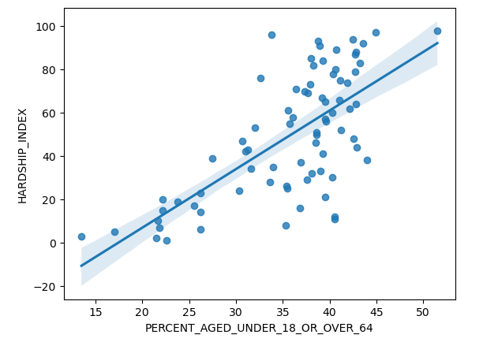
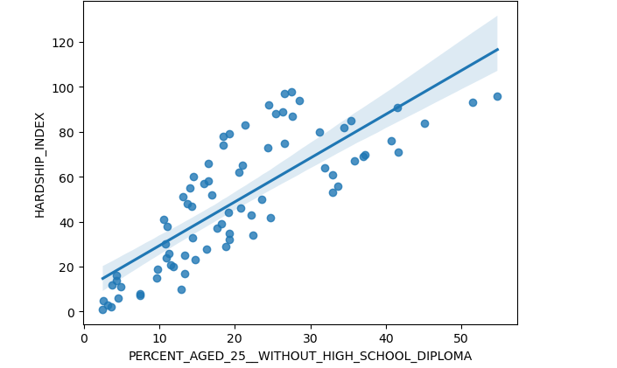
Hardship Index of Citizens
Corr=0.690844
Corr=0.802538

Slide 8
What does it mean?
Findings
Closer correlations in the “without diploma” category of peoples
Crowded housing has a larger impact on the “without diploma” category of peoples but very little impact on citizens under 18/over 65
Implications
Graduating high school leads to better income opportunities
Definition of “crowded housing” may differ between the group of working age people and those who have not yet entered the workforce/retired from the workforce.

Slide 9

Discussion
Increasing the rate of high school graduates may lead to decreased correlation of income burden
While the non working age groups seem to be facing slightly less hardships, efforts should still be made to improve their quality of life

